Slide 1
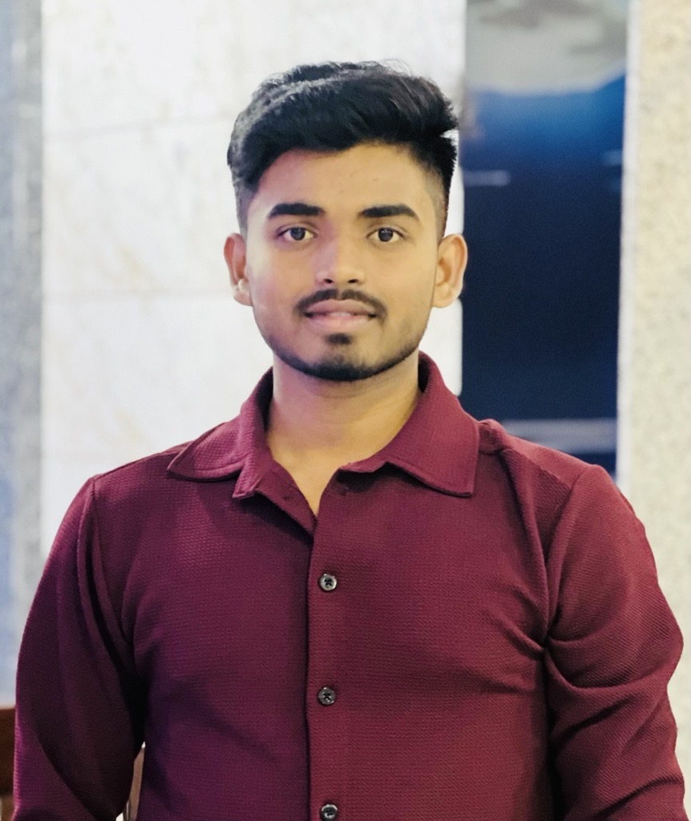

Atul
Analyst
Bachelor of Engineering(Computer Science Engineering), from Chitkara University (HP) INDIA in 2023.
Career
Jan 2024 – present : Capgemini Technology Services,India
Skills
Languages: Java
Technologies : Java, SpringBoot, OOPs, React Native, Restful APIs, Graphql
Code Quality and Testing Frameworks: Junit, Mockito
Data Storage and Management: MySQL Connector
Version Control: Git
SDLC : Agile
Applications/ IDE: IntelliJ, Visual Studio Code
Platforms: Windows, MacOS
Tools: Jira, Postman, Microsoft Azure
Responsibilities
Co-ordinate with QA team and resolve the issues during the testing phase.
Handle the unit testing.
Developed and deployed Java microservices, leveraging Jira for continuous tracking of tasks and sprint progress.
Grade:
A4
Nationality:
Indian
Languages:
EN
Java Developer with 8 months of experience in application development and backend services. Skilled in the full development cycle and focused on building efficient, user-friendly mobile applications. Proficient in Spring Boot for building scalable microservices, with hands-on experience in Kafka through demo projects exploring distributed messaging systems. Strong team player with excellent interpersonal skills, eager to collaborate on dynamic projects. Adept at debugging and optimizing backend services to improve performance and reliability.
Specialties:
API Optimization: Improved API performance with query optimization and caching.
Unit Testing: Increased unit test coverage to 85% using JUnit and Mockito.
Team Collaboration: Worked closely with frontend and DevOps for smooth deployments.
Kafka POC: Demonstrated Kafka’s potential for real-time data streaming.
Backend Development: Strong Java and backend services development skills.
Microservices: Developed scalable microservices using Spring Boot.
Azure: VM setup, Key Vault, IP config, and basic security.
H&M App: Worked as a Backend Developer on the HM app, developing a banner API from scratch. Focused on creating efficient, scalable backend solutions while addressing and resolving bugs to ensure smooth functionality. Collaborated with teams to enhance performance, providing robust solutions and improving overall application reliability.
Roles and Responsibilities:
Handle and process the API Calls.
Involved in analysis, Design, coding and complete the development
Co-ordinate with QA team and resolve the issues during the testing phase.
Bug Fixing and supporting team in handling the issues.
Performed unit testing with JUnit and Mockito to ensure code reliability.
Implemented global exception handling with Spring Boot and Custom Exception Handlers.
Worked with version control tools like Git to manage and maintain code repositories.
Used Jira to report, track, and resolve bugs, ensuring timely fixes.

